Slide 1
Project CREDIT CARD churn Abhradeep Das Gouri Dumale Smit Pancholi Swathi K R

Slide 2
AGENDA
Introduction
Dataset Overview
Descriptive Statistics
Exploratory Data Analysis
Hypotheses for Categorical Variables
Correlation Analysis
Scatter Plots
Logistic Regression

Slide 3
INTRODUCTION
What is Credit card churn ? In simple terms, credit card churn is when people sign up for a new credit card, use it for a while, and then cancel or stop using their old one.
What do we gain ? Customers try to get the best deal out of the products available in the market such as lower interest rates , rewards , cashback etc. by churning through different credit cards.
Why is it an issue ? As customers don’t end up paying interest/minimal fees or discard cards after sign up bonuses , the financial institutions don’t gain any profit from these customers.

Slide 4
Our project dataset contains information distributed across 21 columns for 10127 customers and their interactions with a financial institution. Attrition Flag is a dependent variable. Categorical Variables : 1.Gender 2.Education level 3.Marital status 4.Income category 5.Card category Numerical Variables :
Dataset Overview
1.Client Number 2.Customer Age 3.Dependent Count 4.Months on Book 5.Total relationship count 6.Months inactive in 12M 7.Contacts Count in 12M 8.Credit Limit 9.Total Revolving Balance 10.Avg Open to Buy 11.Total Amount Change Q4 to Q1 12.Total Transaction Amount 13.Total Transaction Count 14.Total Count Change Q4 to Q1 15.Average Utilization Ratio

Slide 5
Descriptive statistics
Credit Limit
Min - 1438
1st Q - 2555
Median - 4549
Mean - 8632
3rd Q - 11068
Max - 34516
Total Transaction Count
Min - 10
1st Q - 45
Median - 67
Mean – 64.9
3rd Q - 81
Max - 139
Customer Age
Min - 26
1st Q - 41
Median 46
Mean – 46.3
3rd Q - 52
Max - 73
Total Transaction Amount
Min - 510
1st Q - 2156
Median - 3899
Mean - 4404
3rd Q - 4741
Max - 18484
Total Revolving Balance
Min - 0
1st Q - 359
Median 1276
Mean - 1163
3rd Q - 1784
Max - 2517

Slide 6
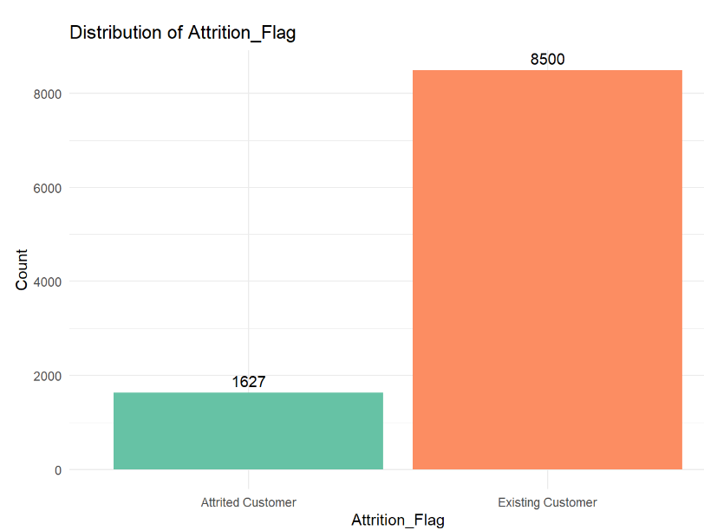
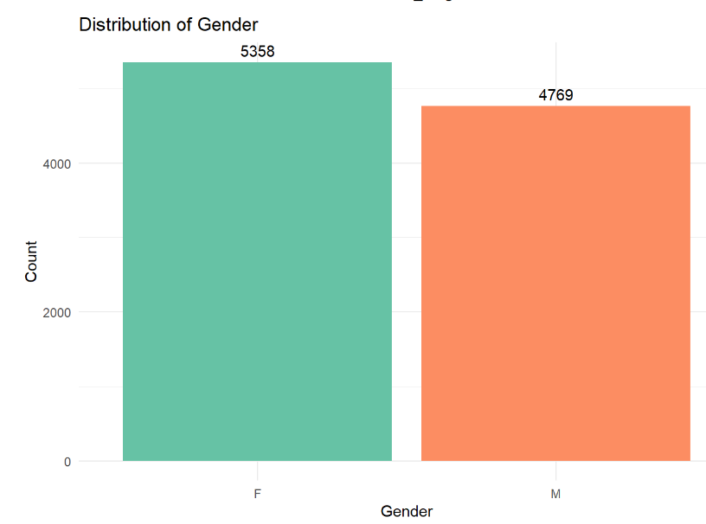
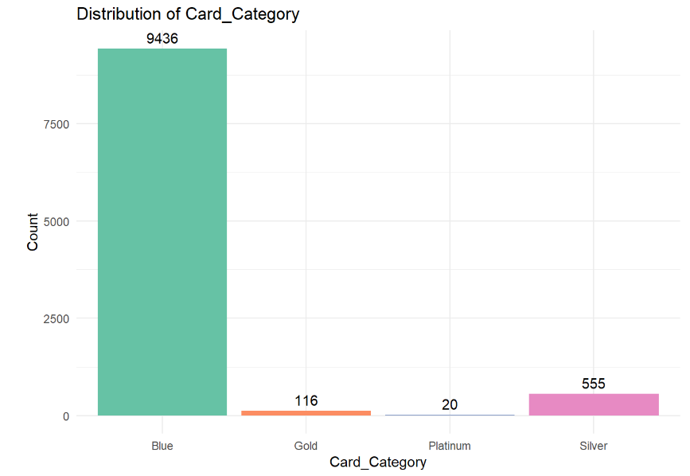
Exploratory data analysis

Slide 7
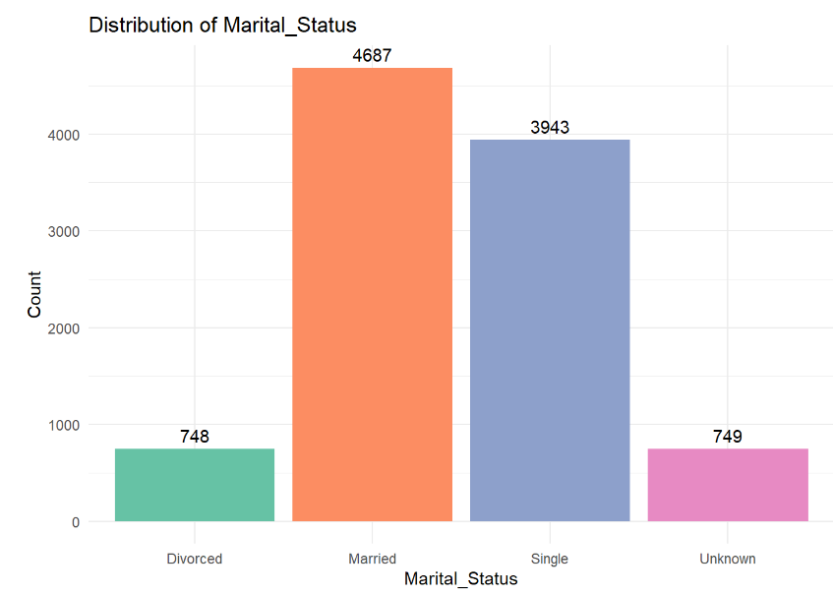
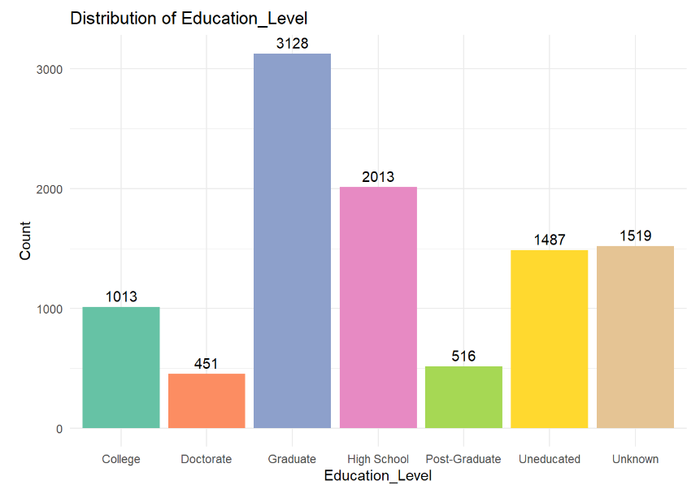
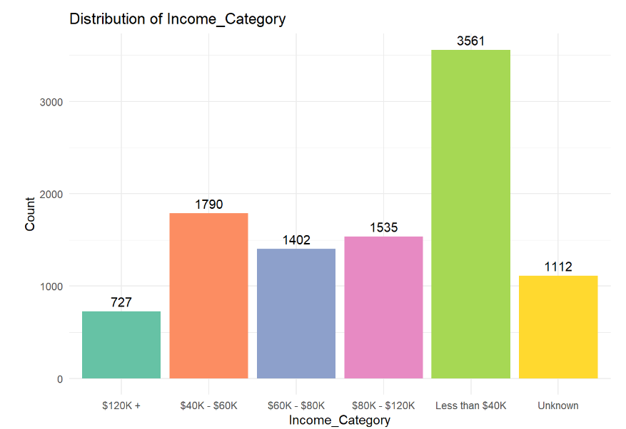

Slide 8
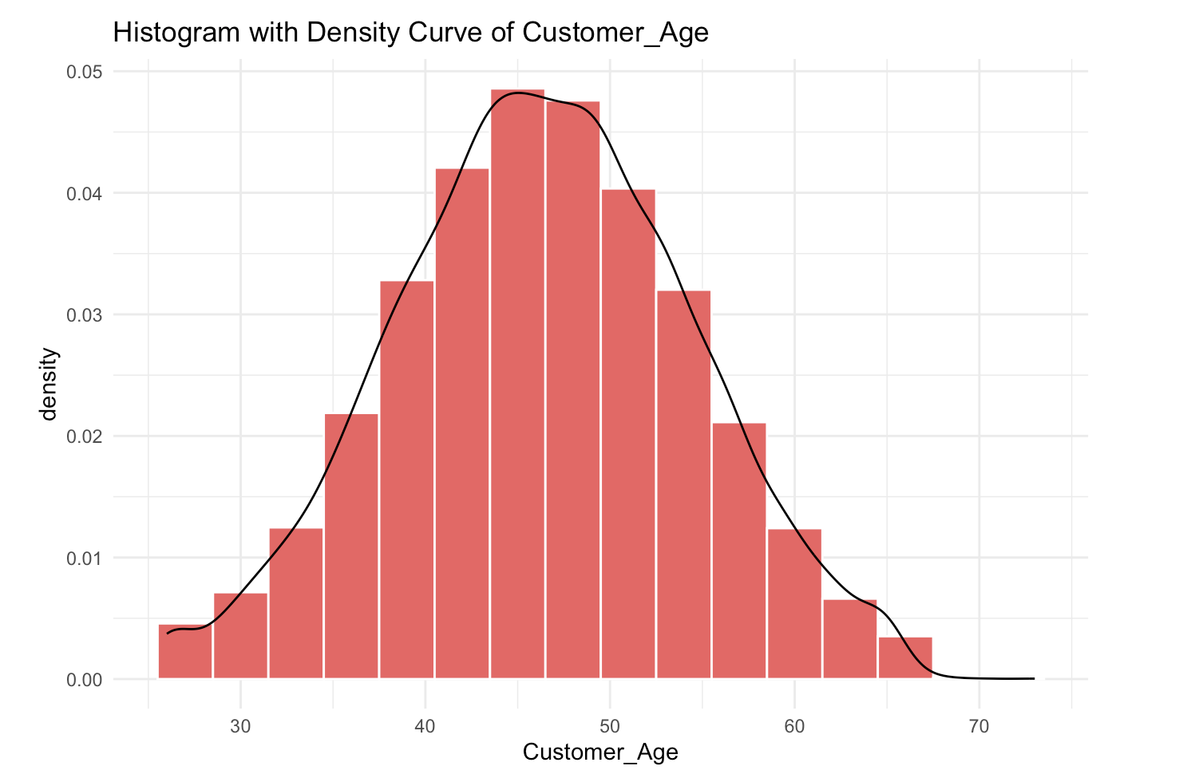
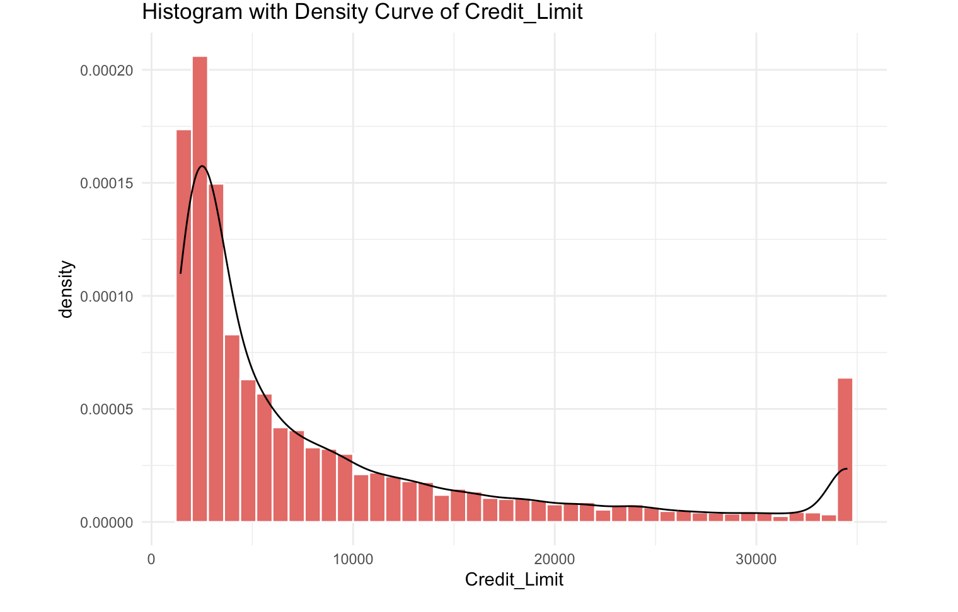
Histogram with Density Curve

Slide 9
Hypotheses for Categorical Variables
Chi-squared test for Gender and Churn
Null Hypothesis (H0): Gender and Churn are independent.
Alternative Hypothesis (H1): Gender and Churn are not independent.
Test:
Pearson's Chi-squared test with Yates' continuity correction
data: churn_data$Gender and churn_data$Attrition_Flag
X-squared = 14, df = 1, p-value = 2e-04
Results:
The X-squared (chi-squared) value is 14, with 1 degree of freedom, and the p-value is 2e-04 (0.0002).
The small p-value (0.0002) indicated a statistically significant association between Gender and Churn. Therefore, we will reject Null Hypothesis(H0).

Slide 10
Chi-squared test for Marital Status and Churn
Null Hypothesis (H0): Marital Status and Churn are independent.
Alternative Hypothesis (H1): Marital Status and Churn are not independent.
Test:
Pearson's Chi-squared
data: churn_data$Marital_Status and churn_data$Attrition_Flag
X-squared = 6, df = 3, p-value = 0.1
Results: The X-squared value is 6, with 3 degrees of freedom, and the p-value is 0.1.
The relatively high p-value (0.1) suggests that there is insufficient evidence to conclude that Marital Status is associated with Churn. Therefore, we will accept Null Hypothesis(H0).

Slide 11
Chi-squared test for Education Level and Churn
Null Hypothesis (H0): Education level and Churn are independent.
Alternative Hypothesis (H1): Education level and Churn are not interdependent.
Test:
Pearson's Chi-squared test
data: churn_data$Education_Level and churn_data$Attrition_Flag
X-squared = 13, df = 6, p-value = 0.05
Results: The X-squared value is 13, with 6 degrees of freedom, and the p-value is 0.05.
The p-value (0.05) is close to the significance threshold. This suggests that there is weak evidence to indicate an association between Education Level and Churn. So, we will reject Null Hypothesis(H0).

Slide 12
Analysis of Variance (ANOVA) test for Age and Churn
Null Hypothesis (H0): The means of Age for churned and non-churned customers are equal.
Alternative Hypothesis (H1): The means of Age for churned and non-churned customers are not equal.
Test:
"Analysis of Variance (ANOVA) for Age and Churn:"
Df Sum Sq Mean Sq F value Pr(>F)
churn_data$Attrition_Flag 1 216 215.6 3.36 0.067
Residuals 10125 650575 64.3
---
Signif. codes: 0 ‘***’ 0.001 ‘**’ 0.01 ‘*’ 0.05 ‘.’ 0.1 ‘ ’ 1
Result: The F-value is 3.36, and the p-value is 0.067.
There is no statistically significant difference in Age between churned and non-churned customers. Therefore, we will accept the Null Hypothesis(H0).

Slide 13
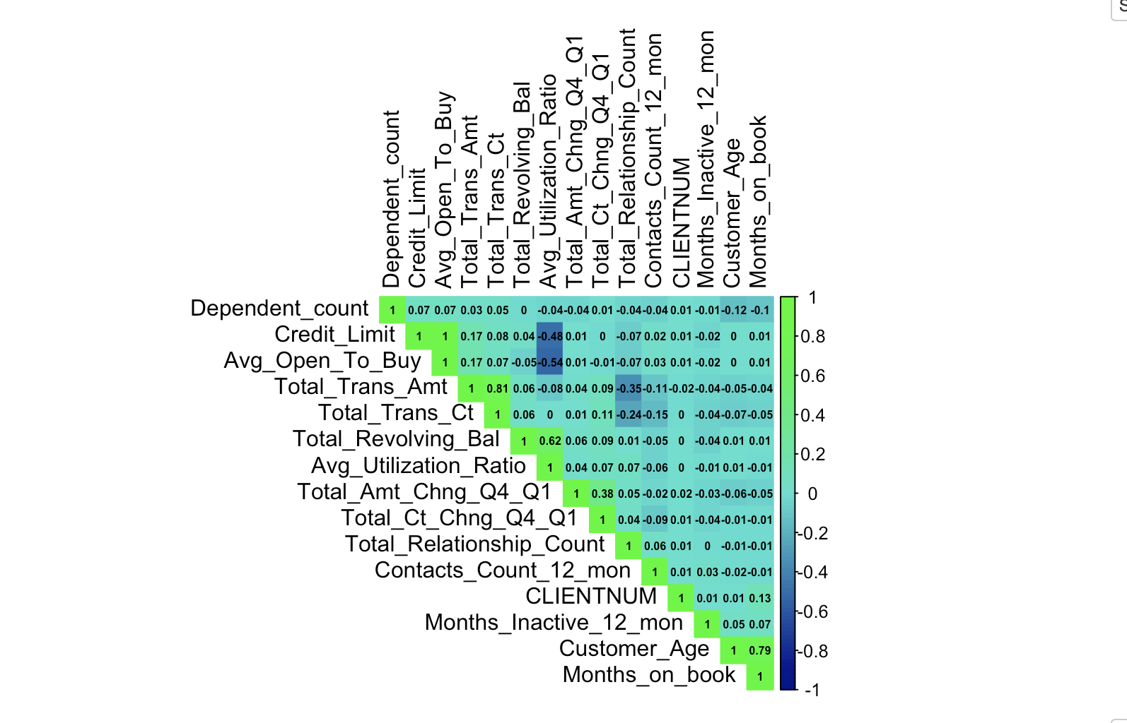
Correlation Analysis
Correlated Pairs:
[1,] "Customer_Age" "Months_on_book"
[2,] "Credit_Limit" “Avg_Open_To_Buy"
[3,] "Total_Revolving_Bal" "Avg_Utilization_Ratio"
[4,] "Total_Trans_Amt" "Total_Trans_Ct"
Correlation 0.789
0.996
0.624
0.807

Slide 14
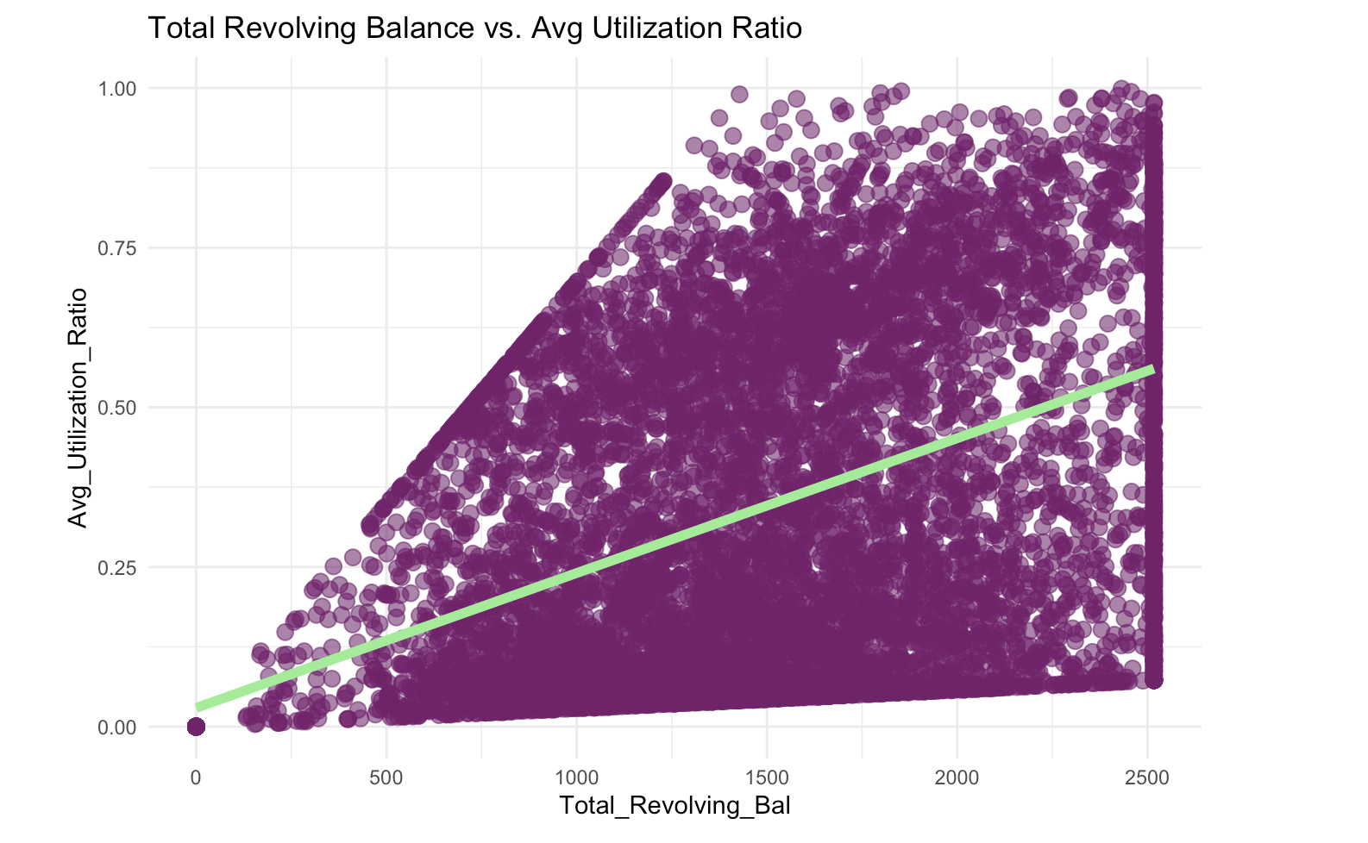
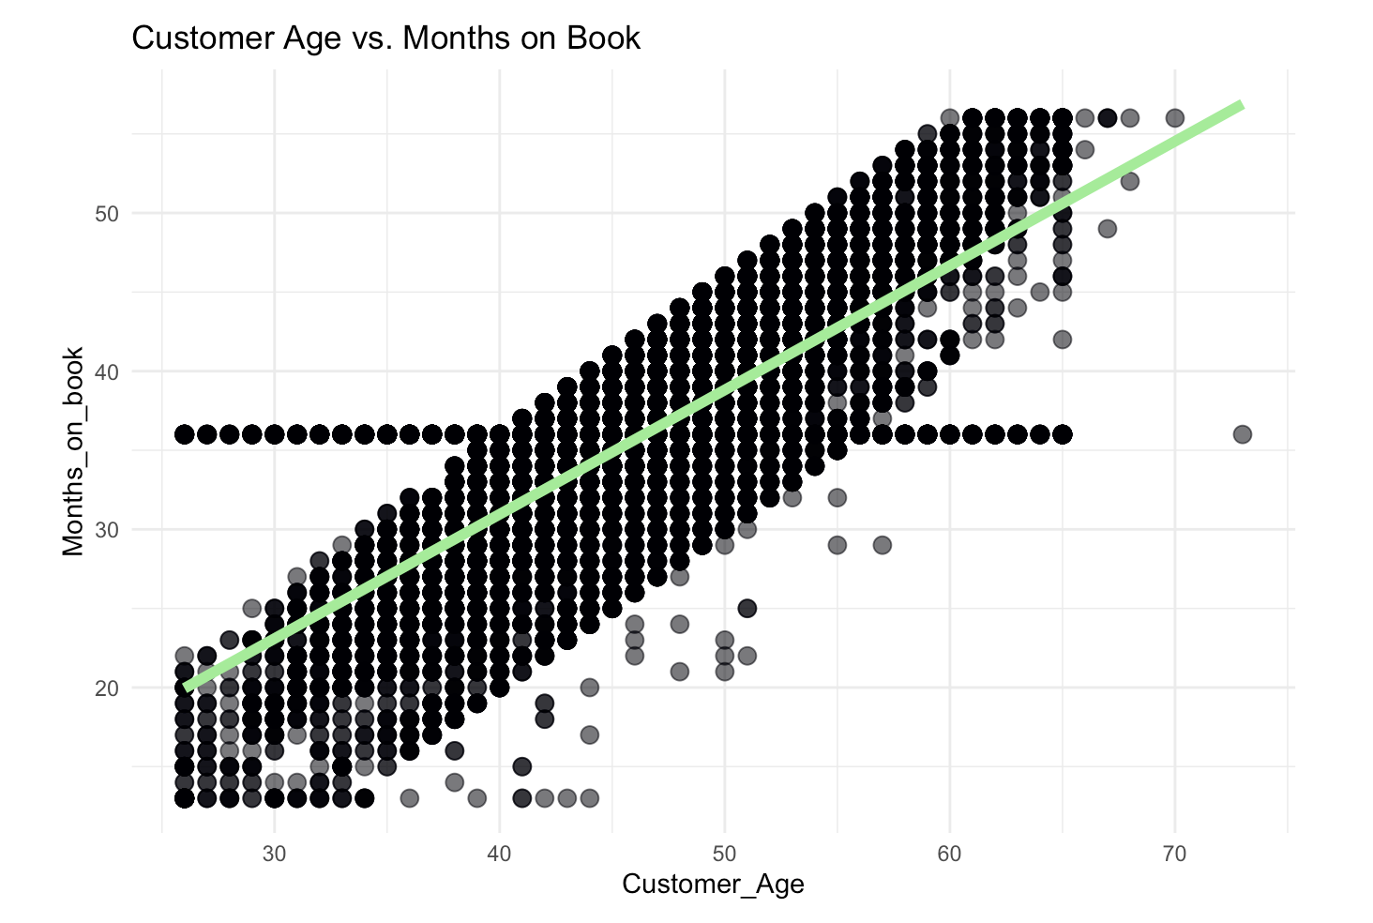
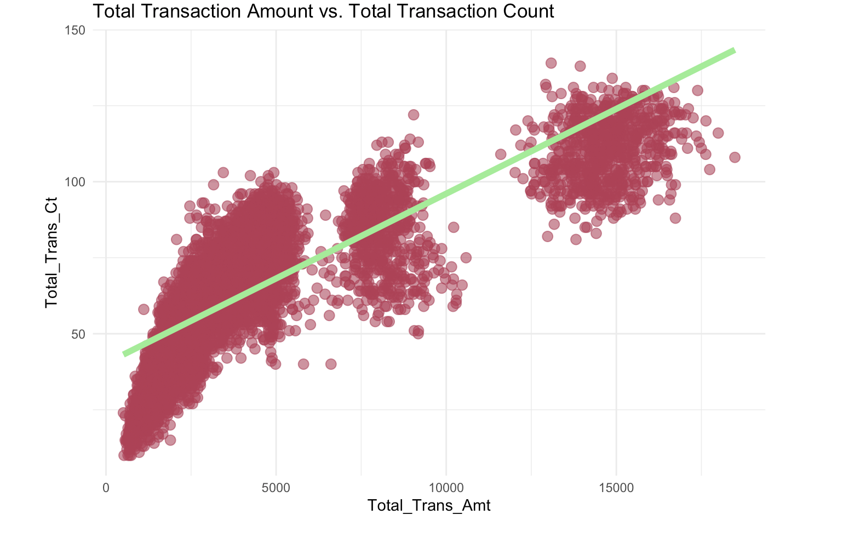
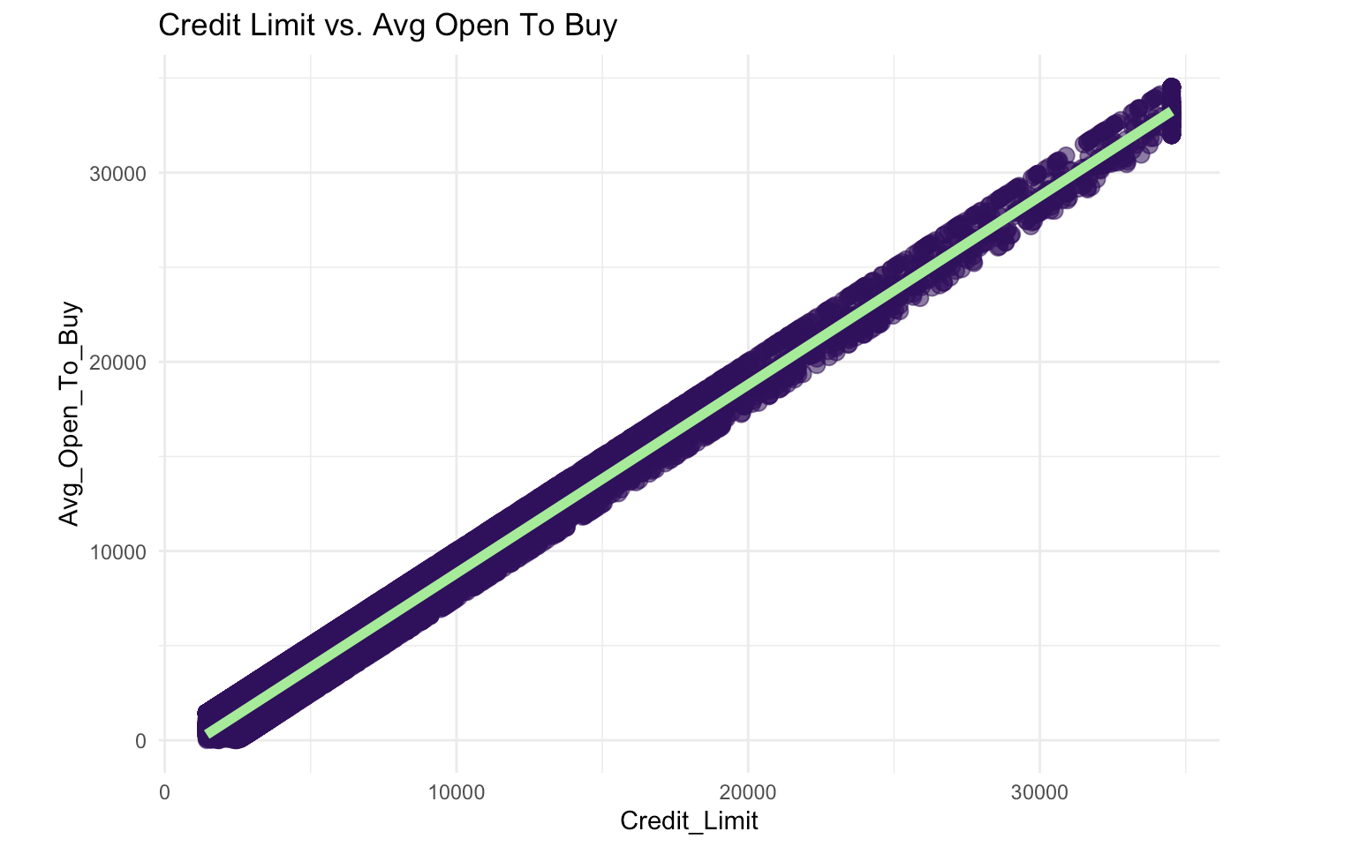

Slide 15
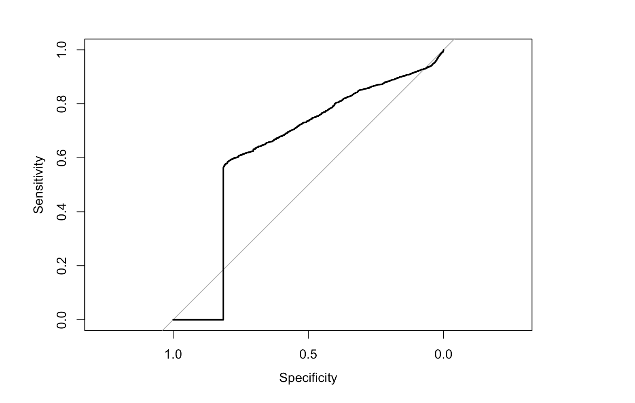
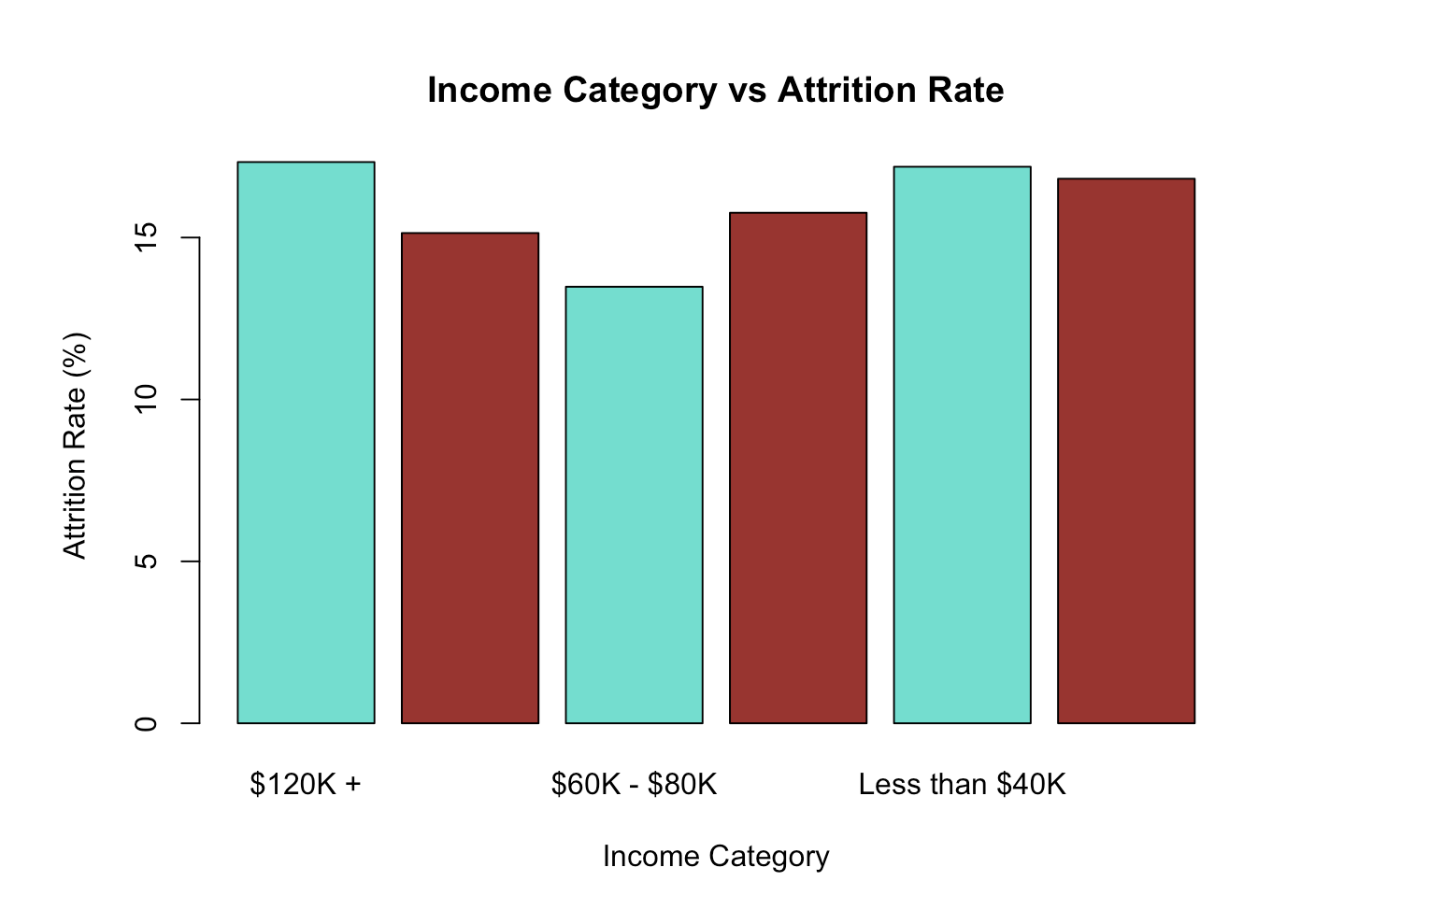
Income Category VS Attrition Rate
Null Hypothesis(H0): There is no association between income category and attrition.
Alternative Hypothesis(H1): There is an association between income category and attrition.
Model Accuracy: 0.839 (83.9%) p-value: <2e-16

Slide 16
Logistic Regression Interpretation
The model achieved an accuracy of 0.839 (83.9%). This means that approximately 83.9% of the total instances were correctly classified by the logistic regression model.
The logistic regression results suggest that the Average Utilization Ratio has a statistically significant impact on the likelihood of customer churn.
The negative coefficient indicates that customers who use their credit cards more frequently and have a higher utilization ratio are less likely to churn.
With a p-value <2e-16, the model is considered a significant improvement, meaning that Average Utilization Ratio is indeed related to the likelihood of churn.

Slide 17
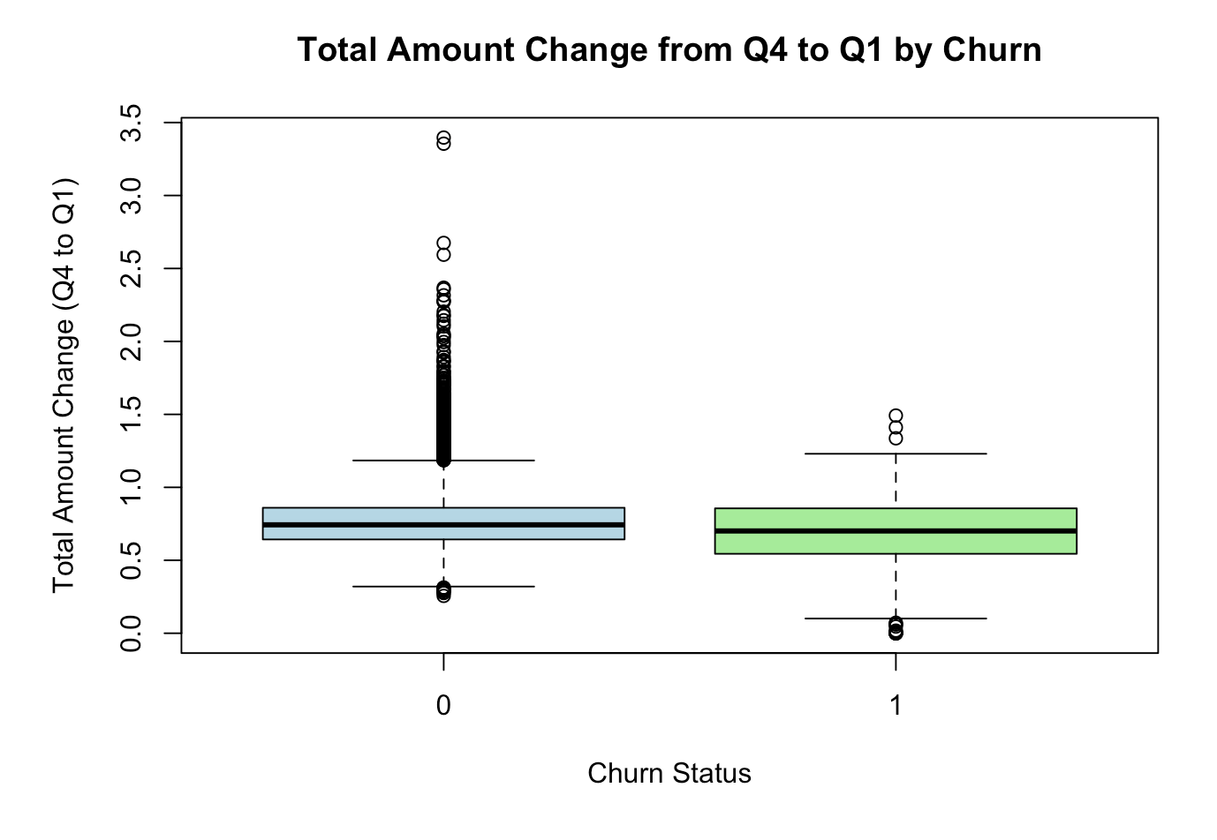
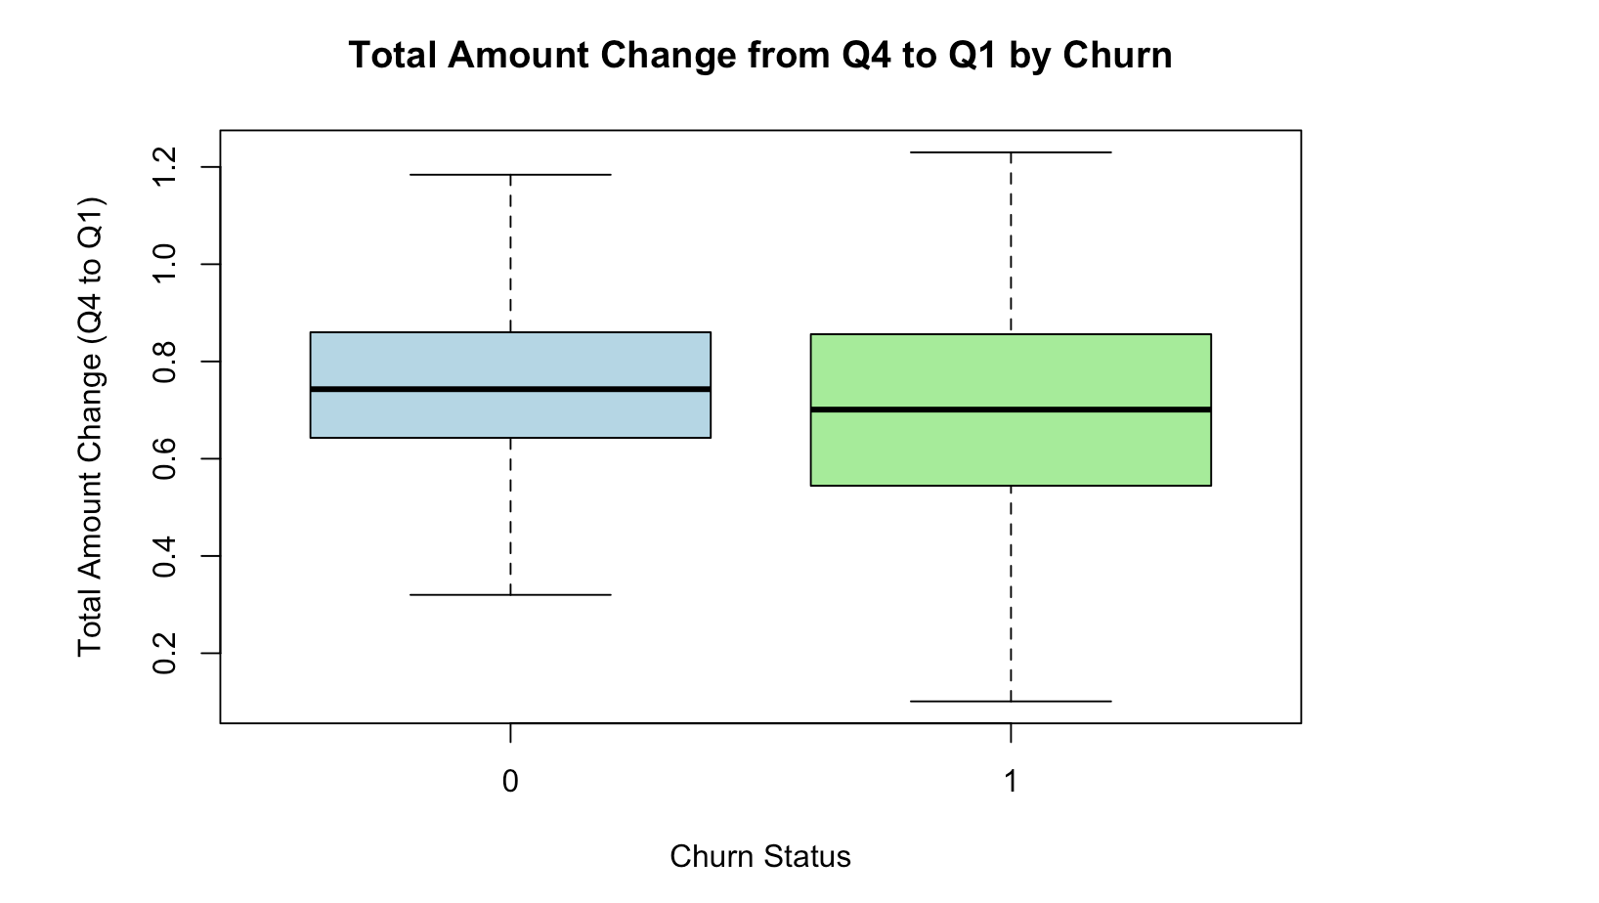
Total amount change between Attrited Customers VS Existing Customers
Null Hypothesis(H0): There is no significant difference in the Total Amount Change from Q4 to Q1 between existing customers and churned customers.
Alternative Hypothesis(H1): There is a significant difference in the Total Amount Change from Q4 to Q1 between existing customers and churned customers.

Slide 18
Interpretation
Based on the results of the Welch Two Sample t-test, we can conclude that there is a statistically significant difference in the Total Amount Change from Q4 to Q1 between existing customers and churned customers.
Therefore, we will reject the null hypothesis.

Slide 19
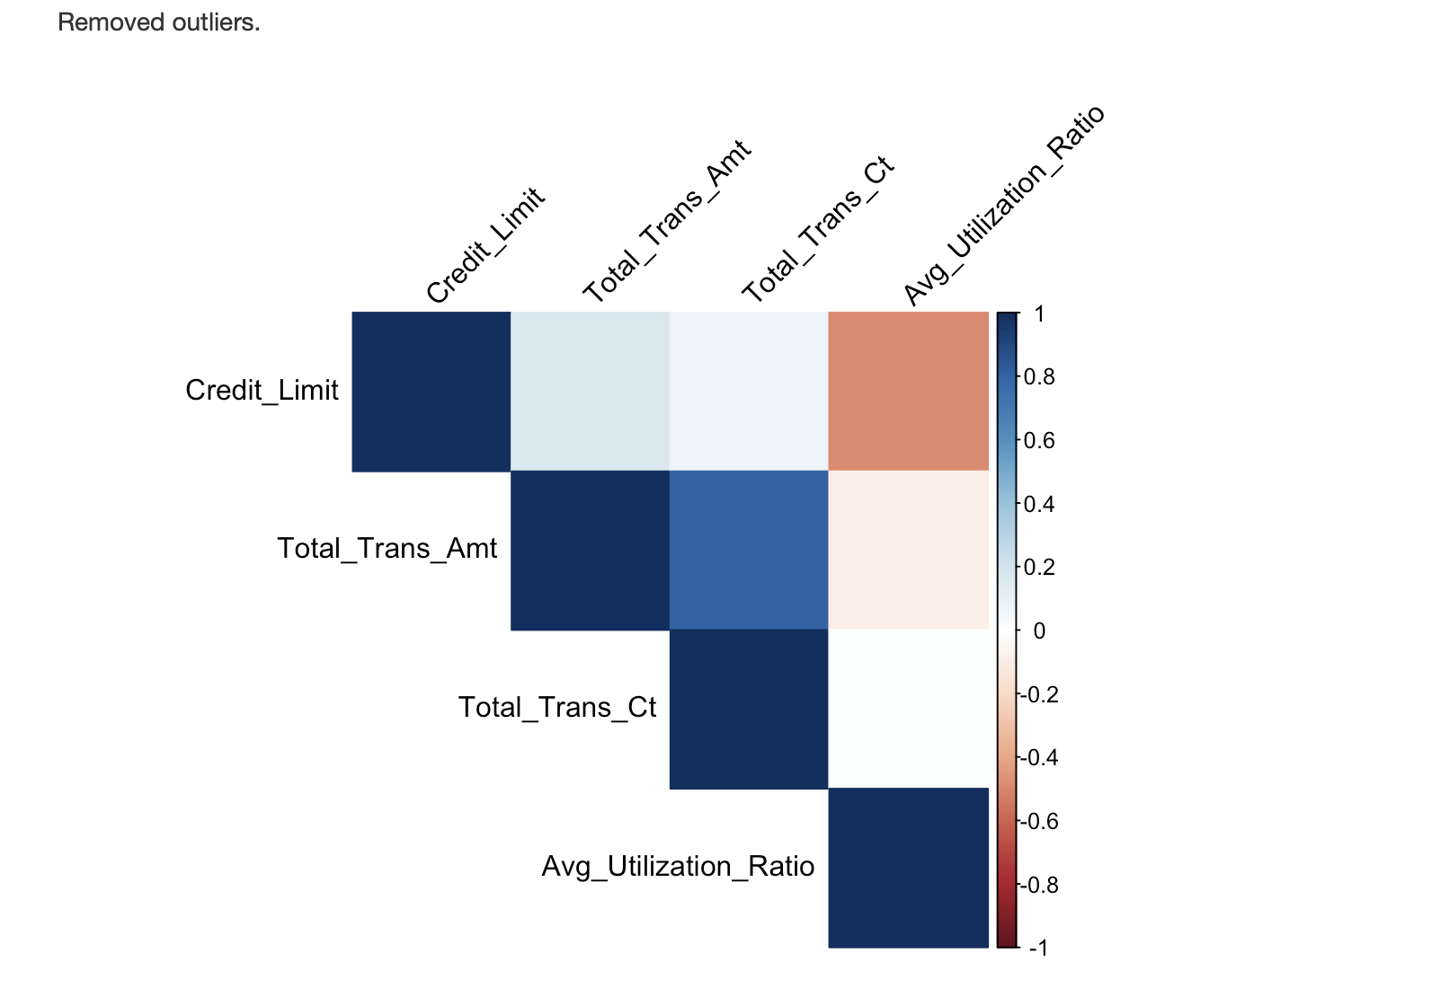
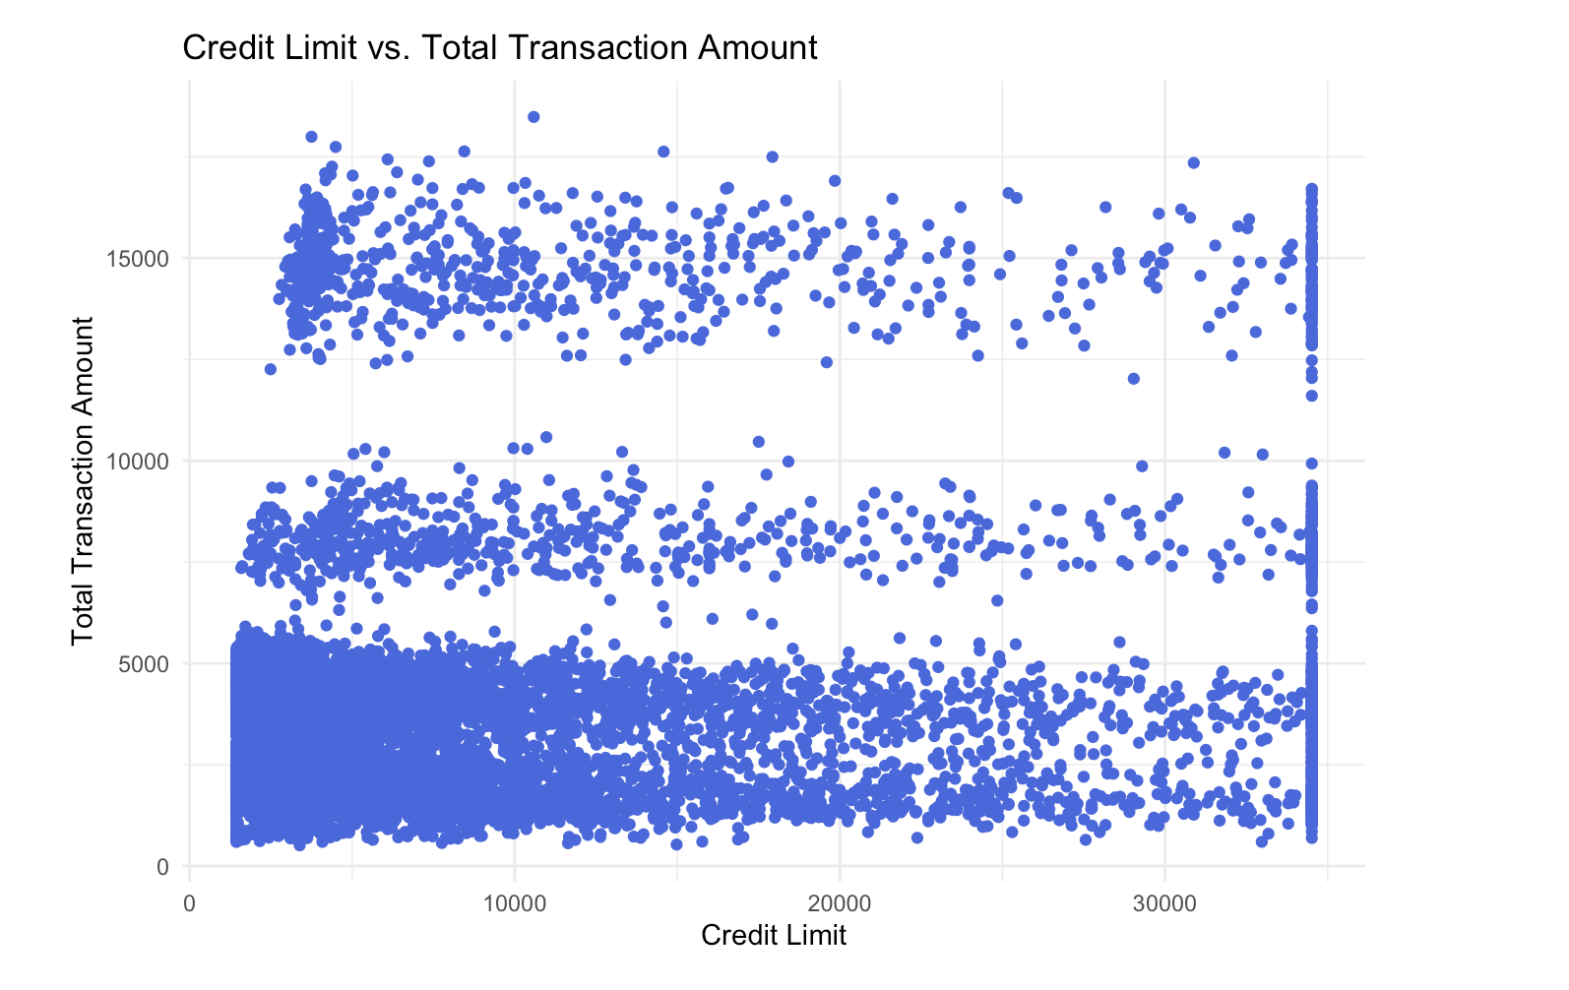
Credit Limit VS Transaction behavior

Slide 20
Interpretation
Credit Limit's coefficient is negative. Therefore, higher credit limits are associated with a lower likelihood of churn.
Since the Total_Trans_Amt is positive, higher transaction amounts are associated with a higher likelihood of churn.
Total_trans_ct's coefficient is negative. Therefore, more transactions are associated with a lower likelihood of churn.
A lower utilization ratio is associated with a lower likelihood of churn.
In summary, the logistic regression analysis indicates that Credit Limit, Total Transaction Amount, Total Transaction Count, and Average Utilization Ratio are significant predictors of churn. Customers with higher credit limit, lower transaction amounts, more transaction counts, and lower utilization ratios are likely to churn.

Slide 21
THANK YOU
https://github.com/smitpancholi313/Project_CreditCardChurn

